Slide 1
Thread Safety in Java
Presented by: Bello Muhammad

Slide 2


Content
What is Thread Safety
Atomicity
Race conditions
Compound actions
Locking
Intrinsic locks
Reentrancy
Guarding state with locks
Liveness and performance
Conclusion

Slide 3

What is Thread Safety
Thread safety is about managing access to state, and in particular to shared, mutable state.
Shared: means a variable could be accessed by multiple threads;
Mutable: means that its value could change during its lifetime.

Slide 4
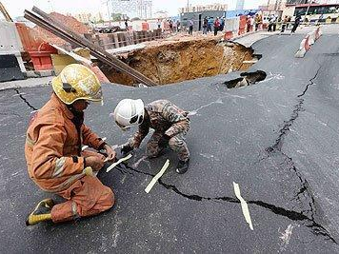
What is Thread Safety Con...
A broken program is the one accessed by multiple threads without appropriate synchronization.
Fix:
Don’t share the state variable across threads;
Make the state variable immutable; or
Use synchronization whenever accessing the state variable.

Slide 5
What is Thread Safety Con...
So a thread safe class behaves correctly regardless of how it is accessed, and it requires no additional synchronization from the caller.
Example: Stateless objects are always thread-safe.
public class StatelessFactorizer { }

Slide 6
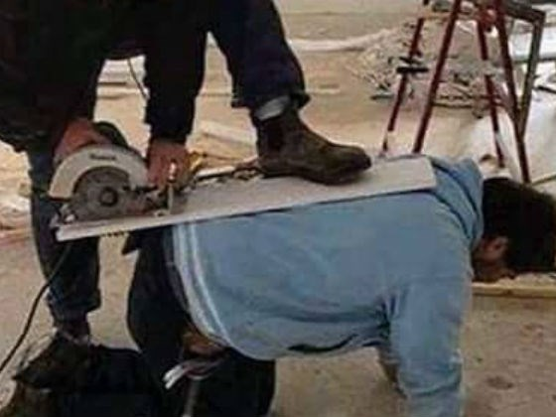
Atomicity
If we are to add state to our StatelessFactorizer, what will happen?
Unsafe: The code in UnsafeFactorizer is not thread-safe. Why?
Because ++count a sequence of three discrete operations known as READ-MODIFY-WRITE
public class UnsafeFactorizer { }

Slide 7
Race Conditions
….
….
public class UnsafeFactorizer { }

Slide 8
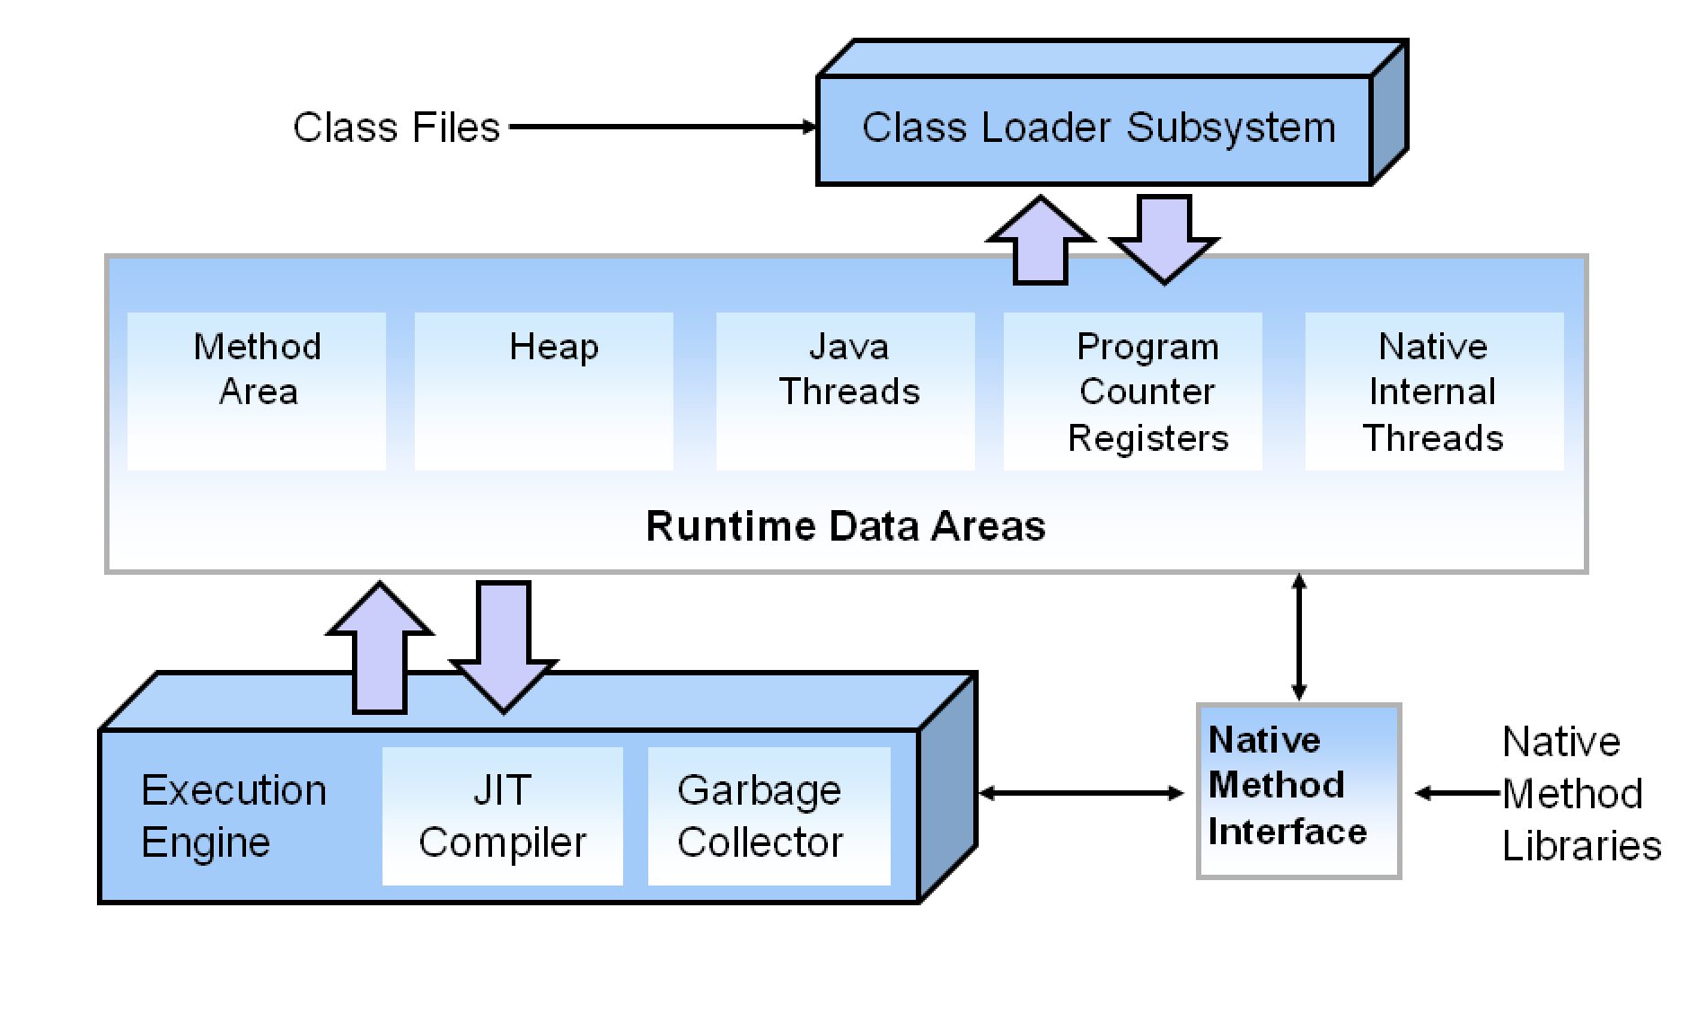
Hotspot Architecture

Slide 9
Class Loader Subsystem
The classloader subsystem is an essential core of the Java Virtual machine and is used for loading/reading the .class. It loads, links and initializes the class when it refers to a class for the first time. Class loader subsystem is responsible for following 3 activities.
Loading: The Class loader reads the .class file, generate the corresponding binary data and save it in method area.
Linking: Performs verification, preparation, and (optionally) resolution.
Initialization: In this phase, all static variables are assigned with their values defined in the code and static block(if any). This is executed from top to bottom in a class and from parent to child in class hierarchy.

Slide 10
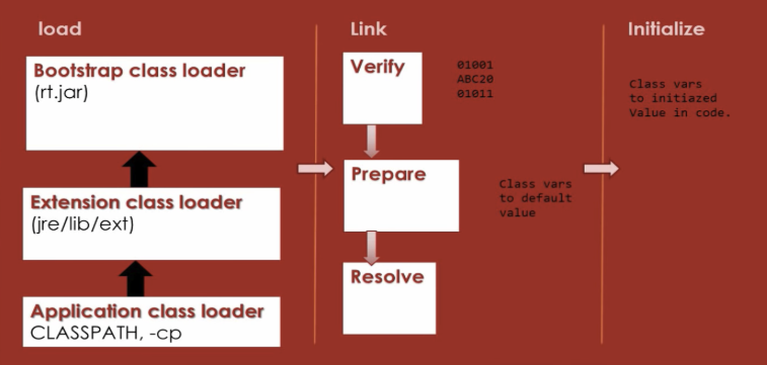
Class Loader Subsystem Cont.

Slide 11
Runtime Data Area
The runtime data area also known as memory management area is divided into five major components.
Method Area
Heap
Java Thread (Stack Area)
Program Counter Register (PC Register)
Native Method Area (Native Method Stack)

Slide 12
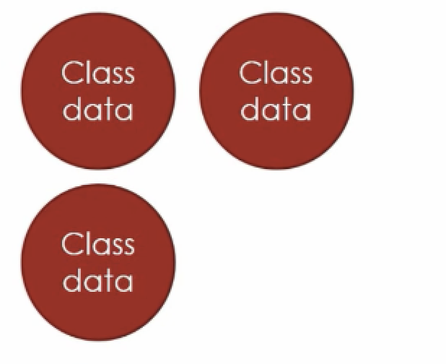
Runtime Data Area Cont.
Method Area:
The method area is the one responsible for holding all class level information like class name, immediate parent class name, methods and variables information etc. are stored, including static variables. There is only one method area per JVM, and it is a shared resource.

Slide 13
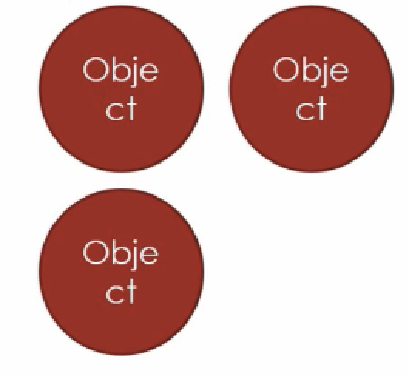
Runtime Data Area Cont.
Heap:
This component is a part of JVM memory where all the objects and its corresponding instance variables and arrays are stored. This memory area is created on the JVM start-up and there is only one heap area shared across multiple threads as the data stored in this area is not thread-safe.

Slide 14
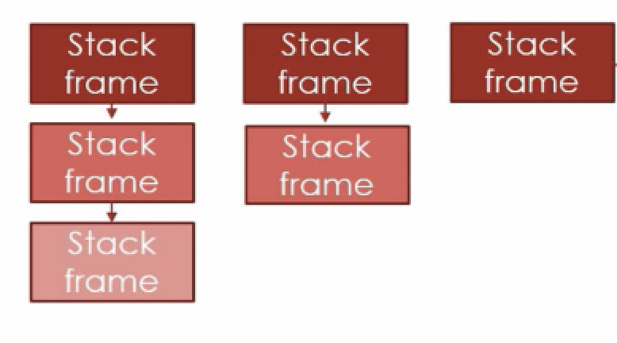
Runtime Data Area Cont.
Java Threads (Stack Threads):
For every thread, JVM create one run-time stack area which is stored here. Every block of this stack is called activation record/stack frame which store methods calls. All local variables of that method are stored in their corresponding frame.The stack area is thread safe since it is not a shared resource. After a thread terminate, it’s run-time stack will be destroyed by JVM.

Slide 15
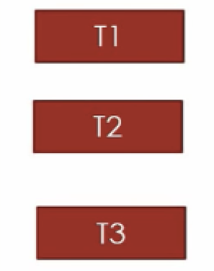
Runtime Data Area Cont.
Program Counter Register (PC Register):
This component holds the address of the JVM instruction which is currently executing. Each thread in Java has its own PC register to hold the address of the currently executing instruction.

Slide 16
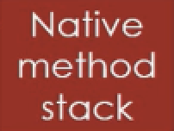
Runtime Data Area Cont.
Native Internal Thread (Native Method Stack):
This component is written in a different language and holds the native method information. Every thread in Java has a separate native method stack. The following exceptional condition is associated with this area.

Slide 17

Execution Engine

Slide 18
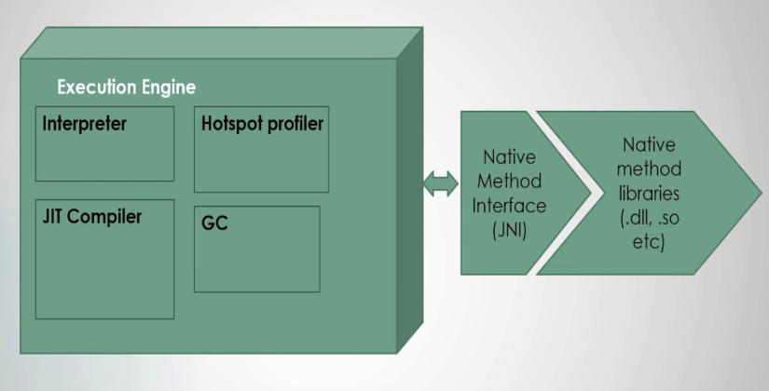
Execution Engine
When everything is alright, the execution engine is then going to execute the generated bytecode. The java code will be executed by both interpreter and JIT compiler simultaneously which will reduce the execution time and then by providing high performance.

Slide 19

Execution Engine Cont.
Hotspot Profiler:
Interpreting bytecodes in the Java virtual machine (JVM) is slow.

Slide 20
Execution Engine Cont.
Hotspot Profiler:
Interpreting bytecodes in the Java virtual machine (JVM) is still exceedingly slow.
The HotSpot profiler looks for "hot spots" in the code, i.e. methods that the JVM spends a significant amount of time running, and then compiles those methods into native generated code.
Let’s say there are some instructions that are been executed again and again, the interpreter will not interpret the instructions again and again. The JIT Compiler will compile those instructions and keeps the target machine code ready for execution.
These set of instructions are like hotspots which the Hotspot Profiler will keep an eye on and then act accordingly to optimize the performance of Java Virtual Machine.

Slide 21
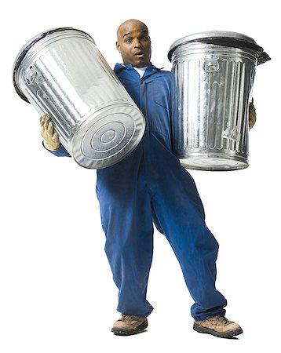
Execution Engine Cont.
Garbage Collector:

Slide 22
Milestones
October 2014
October 2015
August 2015
November 2015
Translate web pages with Chrome extension
Translate text within an app
2014 |  |  |  | 2015
Translate conversations through your Android watch
Translate written text from English or German to Arabic with the click of a camera

Slide 23
What people are saying
With this app, I’m confident to plan a trip to rural Vietnam
Wendy Writer, CA
Visual translation feels like magic
Ronny Reader, NYC
Translate has officially inspired me to learn French
Abby Author, NYC
Quotes for illustration purposes only

Slide 24


Know a 2nd language? Make Google Translate even better by joining the community.
Tip
Inspire your audience to act on the information they just learned.
Depending on your idea, this can be anything from downloading an app to joining an organization.

